Slide 1
Chapter 20: Special Purpose Diodes (Part 1)
Zener Diodes

Slide 2
Objectives
After completing Part 1 of this chapter, you will be able to:
To understand the characteristics and operation of a Zener diode.
To determine Zener impedance

Slide 3
Zener Diodes
Zener diodes behave like ordinary diodes when forward-biased
However, they are designed to breakdown in a controlled manner at a pre-determined voltage when reverse-biased
Once breakdown takes place, voltage across the diode is almost constant
Breakdown voltage is set by carefully controlling doping level during manufacture

Slide 4
Zener Diodes
In contrast to junction diodes, zeners are designed to operate in the reverse-breakdown region
Recall that a junction diode operated in the reverse-breakdown region may cause overheating and damage
Zener diode symbol
Anode (A)
Cathode (K)

Slide 5
Zener Diode vs Rectifier Diode
Normal Operating Region
I_{F} (mA)
I_{F} (mA)
Forward-bias region
V_{R}
V_{BR}
V_{F}
V_{R}
V_{Z}
V_{F}
Reverse-bias region
0.7V
0.7V
Reverse-breakdown
Zener-breakdown region
I_{R}(mA)
I_{R} (mA)
Operating Region of a Rectifier Diode
Operating Region of a Zener Diode

Slide 6
Breakdown in Zener Diode
2 types of reverse biased breakdown in Zeners
Zener breakdown
Occurs at low reverse voltage (typically < 5V) because of heavy doping
Ordinary working region of Zener
Avalanche breakdown
Occurs typically at reverse voltage >> 5V
Should avoid operating in this region as the Zener diode will be damaged

Slide 7
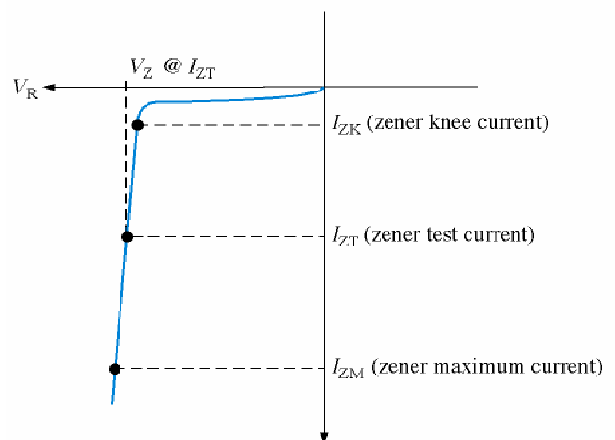
Breakdown in Zener Diode
V_{Z} (zener voltage) is usually specified at I_{ZT} (the zener test current), and is designated V_{ZT}
Zener Breakdown region
Operating Region
Avoid this Region
Avalanche Breakdown region
V-I Characteristic of Zener Diode

Slide 8
Practical Zener Diode
An ideal Zener is one where the breakdown characteristic is vertical
i.e. voltage of Zener is constant regardless of current passing through
In practical Zeners, however, voltage changes in response to changes in current
ΔI_{Z} in a Zener produces small changes ΔV_{Z}

Slide 9
Practical Zener Diode
Z_{Z} is assumed constant over the full linear range of Zener current values and is purely resistive
Hence

Slide 10
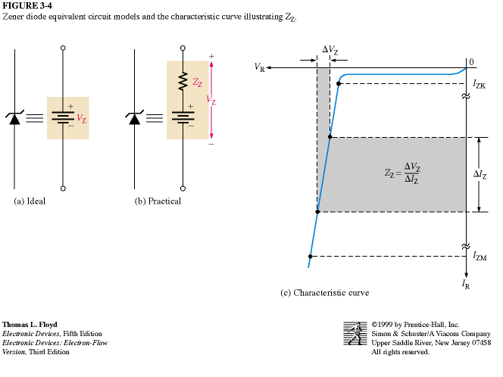
Practical Zener Diode
Hence a practical zener can be modeled as the equivalent of
A voltage source
A “resistor-like” property known as impedence
Model of ideal vs. practical zeners
Using Ohm’s Law, impedance of Zener Z_{z} is
or

Slide 11
Worked example
EXAMPLE 20-1
A Zener diode exhibits a certain change in V_{Z} for a certain change in I_{Z} on a portion of the linear characteristic curve between I_{ZK} and I_{ZM} as illustrated.
What is the Zener impedance?
 V_{Z} = 30mV
V_{R}
I_{ZK}
12mA
 I_{Z} =6mA
18mA
I_{ZM}
I_{R}
Solution :

Slide 12
Worked example
Example 20-2
IN4736 Zener diode has Z_{ZT} = 3.5Ω, V_{ZT} = 6.8V, I_{ZT} = 37mA and I_{ZK} = 1 mA.
What is the voltage across the diode terminals when:
(i) I_{Z} = 50 mA and (ii) I_{Z} = 25 mA ?

Slide 13
Worked example
 V_{Z}
V_{ZT} = 6.8 V
V_{R}
I_{ZK} = 1 mA
Vz = ?
 V_{Z}
Vz = ?
I_{Z} = 25 mA
 I_{Z} = ?
I_{ZT} = 37 mA
V_{Z}= V_{ZT} +  V_{Z}
 I_{Z} = ?
I_{Z} = 50 mA
I_{ZM}
I_{R}

Slide 14
Worked example
Solution 2(i)
ΔI_{Z} = I_{Z} – I_{ZT} = 50 - 37 = 13mA
ΔV_{Z} = ΔI_{Z} x Z_{ZT} = 13mA x 3.5Ω = 45.5mV
V_{Z} = V_{ZT} + ΔV_{Z} = 6.8V + 45.5mV = 6.8455V
Solution 2(ii)
ΔI_{Z} = I_{Z} – I_{ZT} = 25 - 37 = -12mA
ΔV_{Z} = ΔI_{Z} x Z_{ZT} = (-12mA) x 3.5Ω = -42mV
V_{Z} = V_{ZT} + ΔV_{Z} = 6.8V + (-42mV) = 6.758V

Slide 15
Zener Diode Applications
In the past Zener Diodes were widely used to regulate D.C. voltages
But IC voltage regulators are now more commonly used for this purpose
Voltage across R₂ is always less than or equal to V_{ZT} regardless of R₁ and R₂ values
+
10V
V_{ZT}
R₂
-
R₁

Slide 16
Summary
A Zener diode is normally operated in the reversed-bias mode.
When a Zener diode reaches its reverse breakdown voltage level, it maintains a nearly constant voltage.
The Zener characteristics curve shows important characteristics such as Zener test voltage, Zener test current and Zener maximum voltage.
Zener impedance is defined as :

Slide 17
End of Chapter 20 (Part 1)
17

